Slide 1
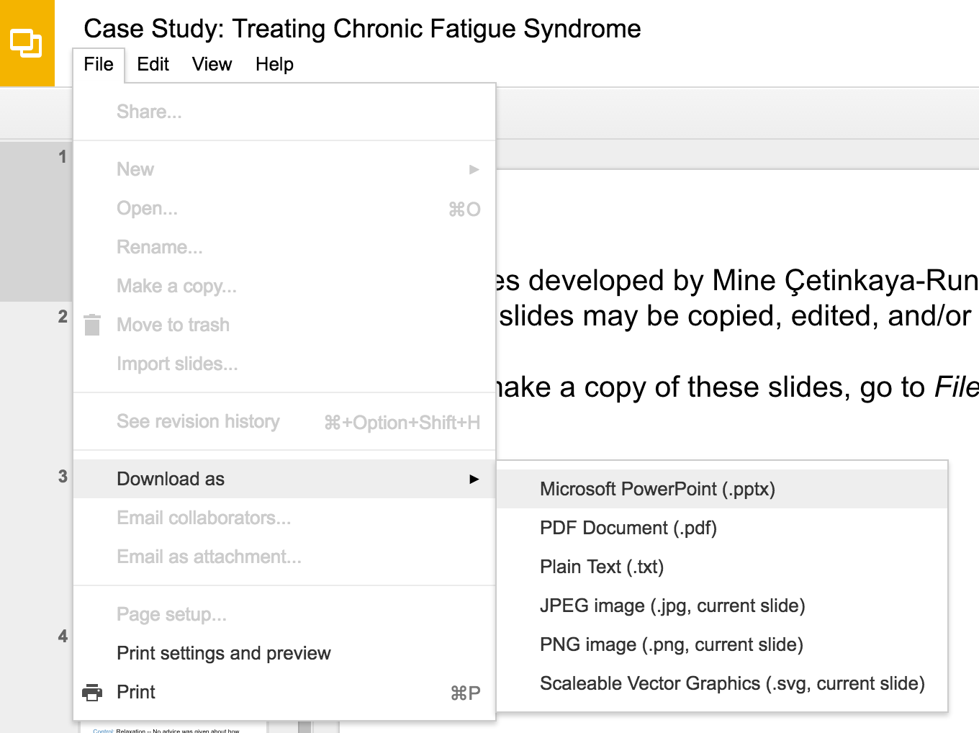
Slides developed by Mine Çetinkaya-Rundel of OpenIntro
Translated from LaTeX to Google Slides by Curry W. Hilton of OpenIntro.
The slides may be copied, edited, and/or shared via the CC BY-SA license
To make a copy of these slides, go to File > Download as > [option], as shown below. Or if you are logged into a Google account, you can choose Make a copy... to create your own version in Google Drive.

Slide 2
Hypothesis Testing for a Proportion

Slide 3
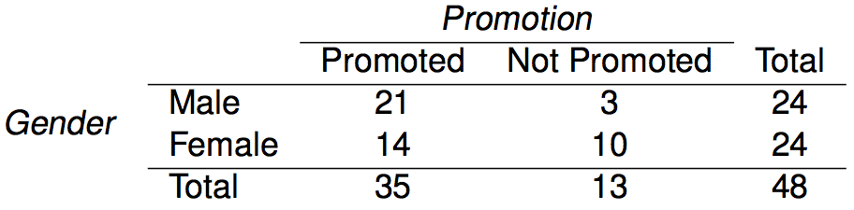
Remember when...
Gender discrimination experiment:

Slide 4
Remember when...
Gender discrimination experiment:
p̂_{males} = 21 / 24 = 0.88
p̂_{females} = 14 / 24 = 0.58

Slide 5
Remember when...
Gender discrimination experiment:
p̂_{males} = 21 / 24 = 0.88
p̂_{females} = 14 / 24 = 0.58
Possible explanations:
Promotion and gender are independent, no gender discrimination, observed difference in proportions is simply due to chance. → null (nothing is going on)
Promotion and gender are dependent, there is gender discrimination, observed difference in proportions is not due to chance. → alternative (something is going on)

Slide 6
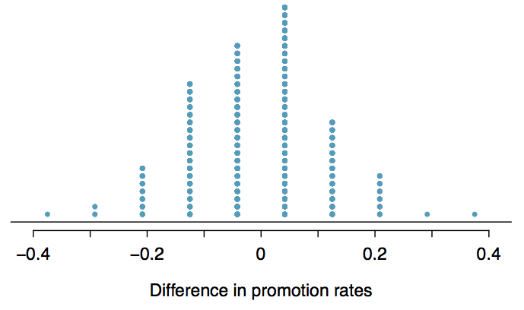
Result

Slide 7
Result
Since it was quite unlikely to obtain results like the actual data or something more extreme in the simulations (male promotions being 30% or more higher than female promotions), we decided to reject the null hypothesis in favor of the alternative.

Slide 8
Recap: hypothesis testing framework
We start with a null hypothesis (H₀) that represents the status quo.

Slide 9
Recap: hypothesis testing framework
We start with a null hypothesis (H₀) that represents the status quo.
We also have an alternative hypothesis (H_{A}) that represents our research question, i.e. what we're testing for.

Slide 10
Recap: hypothesis testing framework
We start with a null hypothesis (H₀) that represents the status quo.
We also have an alternative hypothesis (H_{A}) that represents our research question, i.e. what we're testing for.
We conduct a hypothesis test under the assumption that the null hypothesis is true, either via simulation or traditional methods based on the central limit theorem (coming up next...).

Slide 11
Recap: hypothesis testing framework
We start with a null hypothesis (H₀) that represents the status quo.
We also have an alternative hypothesis (H_{A}) that represents our research question, i.e. what we're testing for.
We conduct a hypothesis test under the assumption that the null hypothesis is true, either via simulation or traditional methods based on the central limit theorem (coming up next...).
If the test results suggest that the data do not provide convincing evidence for the alternative hypothesis, we stick with the null hypothesis. If they do, then we reject the null hypothesis in favor of the alternative.

Slide 12
Recap: hypothesis testing framework
We start with a null hypothesis (H₀) that represents the status quo.
We also have an alternative hypothesis (H_{A}) that represents our research question, i.e. what we're testing for.
We conduct a hypothesis test under the assumption that the null hypothesis is true, either via simulation or traditional methods based on the central limit theorem (coming up next...).
If the test results suggest that the data do not provide convincing evidence for the alternative hypothesis, we stick with the null hypothesis. If they do, then we reject the null hypothesis in favor of the alternative.
We'll formally introduce the hypothesis testing framework using an example on testing a claim about a population mean.

Slide 13
Testing hypotheses using confidence intervals
Earlier we calculated a 95% confidence interval for the proporton of American Facebook users who think Facebook categorizes their interests accurately as 64% to 67%. Based on this confidence interval, do the data support the hypothesis that majority of American Facebook users think Facebook categorizes their interests accurately.
The associated hypotheses are: H₀: p = 0.50: 50% of American Facebook users think Facebook categorizes their interests accurately H_{A}: p > 0.50: More than 50% of American Facebook users think Facebook categorizes their interests accurately
Null value is not included in the interval → reject the null hypothesis.
This is a quick-and-dirty approach for hypothesis testing, but it doesn’t tell us the likelihood of certain outcomes under the null hypothesis (p-value)

Slide 14
Decision errors
Hypothesis tests are not flawless.
In the court system innocent people are sometimes wrongly convicted, and the guilty sometimes walk free.
Similarly, we can make a wrong decision in statistical hypothesis tests as well.
The difference is that we have the tools necessary to quantify how often we make errors in statistics.

Slide 15
Decision errors (cont.)
There are two competing hypotheses: the null and the alternative. In a hypothesis test, we make a decision about which might be true, but our choice might be incorrect.

Slide 16
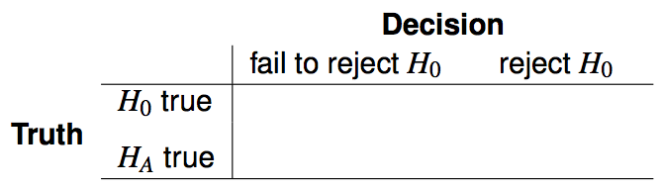
Decision errors (cont.)
There are two competing hypotheses: the null and the alternative. In a hypothesis test, we make a decision about which might be true, but our choice might be incorrect.

Slide 17
Decision errors (cont.)
There are two competing hypotheses: the null and the alternative. In a hypothesis test, we make a decision about which might be true, but our choice might be incorrect.

Slide 18
Decision errors (cont.)
There are two competing hypotheses: the null and the alternative. In a hypothesis test, we make a decision about which might be true, but our choice might be incorrect.

Slide 19

Decision errors (cont.)
There are two competing hypotheses: the null and the alternative. In a hypothesis test, we make a decision about which might be true, but our choice might be incorrect.
A Type 1 Error is rejecting the null hypothesis when H₀ is true.

Slide 20

Decision errors (cont.)
There are two competing hypotheses: the null and the alternative. In a hypothesis test, we make a decision about which might be true, but our choice might be incorrect.
A Type 1 Error is rejecting the null hypothesis when H₀ is true.
A Type 2 Error is failing to reject the null hypothesis when H_{A} is true.

Slide 21
Decision errors (cont.)
There are two competing hypotheses: the null and the alternative. In a hypothesis test, we make a decision about which might be true, but our choice might be incorrect.
A Type 1 Error is rejecting the null hypothesis when H₀ is true.
A Type 2 Error is failing to reject the null hypothesis when H_{A} is true.
We (almost) never know if H₀ or H_{A} is true, but we need to consider all possibilities.

Slide 22
Hypothesis Test as a trial
If we again think of a hypothesis test as a criminal trial then it makes sense to frame the verdict in terms of the null and alternative hypotheses:
H₀: Defendant is innocent
H_{A}: Defendant is guilty
Which type of error is being committed in the following circumstances?
Declaring the defendant innocent when they are actually guilty
Declaring the defendant guilty when they are actually innocent

Slide 23
Hypothesis Test as a trial
If we again think of a hypothesis test as a criminal trial then it makes sense to frame the verdict in terms of the null and alternative hypotheses:
H₀: Defendant is innocent
H_{A}: Defendant is guilty
Which type of error is being committed in the following circumstances?
Declaring the defendant innocent when they are actually guilty
Type 2 error
Declaring the defendant guilty when they are actually innocent

Slide 24
Hypothesis Test as a trial
If we again think of a hypothesis test as a criminal trial then it makes sense to frame the verdict in terms of the null and alternative hypotheses:
H₀: Defendant is innocent
H_{A}: Defendant is guilty
Which type of error is being committed in the following circumstances?
Declaring the defendant innocent when they are actually guilty
Type 2 error
Declaring the defendant guilty when they are actually innocent
Type 1 error
Which error do you think is the worse error to make?

Slide 25
Hypothesis Test as a trial
If we again think of a hypothesis test as a criminal trial then it makes sense to frame the verdict in terms of the null and alternative hypotheses:
H₀: Defendant is innocent
H_{A}: Defendant is guilty
Which type of error is being committed in the following circumstances?
Declaring the defendant innocent when they are actually guilty
Type 2 error
Declaring the defendant guilty when they are actually innocent
Type 1 error
Which error do you think is the worse error to make?
“better that ten guilty persons escape than that one innocent suffer” - William Blackstone

Slide 26
Type 1 error rate
As a general rule we reject H₀ when the p-value is less than 0.05, i.e. we use a significance level of 0.05, α = 0.05.

Slide 27
Type 1 error rate
As a general rule we reject H₀ when the p-value is less than 0.05, i.e. we use a significance level of 0.05, α = 0.05.
This means that, for those cases where H₀ is actually true, we do not want to incorrectly reject it more than 5% of those times.

Slide 28
Type 1 error rate
As a general rule we reject H₀ when the p-value is less than 0.05, i.e. we use a significance level of 0.05, α = 0.05.
This means that, for those cases where H₀ is actually true, we do not want to incorrectly reject it more than 5% of those times.
In other words, when using a 5% significance level there is about 5% chance of making a Type 1 error if the null hypothesis is true. P(Type 1 error | H₀ true) = α

Slide 29
Type 1 error rate
As a general rule we reject H₀ when the p-value is less than 0.05, i.e. we use a significance level of 0.05, α = 0.05.
This means that, for those cases where H₀ is actually true, we do not want to incorrectly reject it more than 5% of those times.
In other words, when using a 5% significance level there is about 5% chance of making a Type 1 error if the null hypothesis is true. P(Type 1 error | H₀ true) = α
This is why we prefer small values of α -- increasing α increases the Type 1 error rate.

Slide 30
Facebook interest categories
The same survey asked the 850 respondents how comfortable they are with Facebook creating a list of categories for them. 41% of the respondents said they are comfortable. Do these data provide convincing evidence that the proportion of American Facebook users are comfortable with Facebook creating a list of interest categories for them is different than 50%?
https://www.pewinternet.org/2019/01/16/facebook-algorithms-and-personal-data/

Slide 31
Facebook interest categories
The same survey asked the 850 respondents how comfortable they are with Facebook creating a list of categories for them. 41% of the respondents said they are comfortable. Do these data provide convincing evidence that the proportion of American Facebook users are comfortable with Facebook creating a list of interest categories for them is different than 50%?
Setting the hypotheses The parameter of interest is the proportion of all American Facebook users who are comfortable with Facebook creating categories of interests for them.
There may be two explanations why our sample proportion is lower than 0.50 (minority).
The true population proportion is different than 0.50.
The true population mean is 0.50, and the difference between the true population proportion and the sample proportion is simply due to natural sampling variability.

Slide 32
Facebook interest categories
The same survey asked the 850 respondents how comfortable they are with Facebook creating a list of categories for them. 41% of the respondents said they are comfortable. Do these data provide convincing evidence that the proportion of American Facebook users are comfortable with Facebook creating a list of interest categories for them is different than 50%?
Setting the hypotheses We start with the assumption that 50% of American Facebook users are comfortable with Facebook creating categories of interests for them
H₀: p = 0.50
We test the claim that the proportion of American Facebook users who are comfortable with Facebook creating categories of interests for them is different than 50%.
H_{A}: p ≠ 0.50

Slide 33
Facebook interest categories - conditions
Which of the following is not a condition that needs to be met to proceed with this hypothesis test?
Respondents in the sample should be independent of each other with respect to whether or not they feel comfortable with their interests being categorized by Facebook.
Sampling should have been done randomly.
The sample size should be less than 10% of the population of all American Facebook users.
There should be at least 30 respondents in the sample.
There should be at least 10 expected successes and 10 expected failure.

Slide 34
Facebook interest categories - conditions
Which of the following is not a condition that needs to be met to proceed with this hypothesis test?
Respondents in the sample should be independent of each other with respect to whether or not they feel comfortable with their interests being categorized by Facebook.
Sampling should have been done randomly.
The sample size should be less than 10% of the population of all American Facebook users.
There should be at least 30 respondents in the sample.
There should be at least 10 expected successes and 10 expected failure.

Slide 35
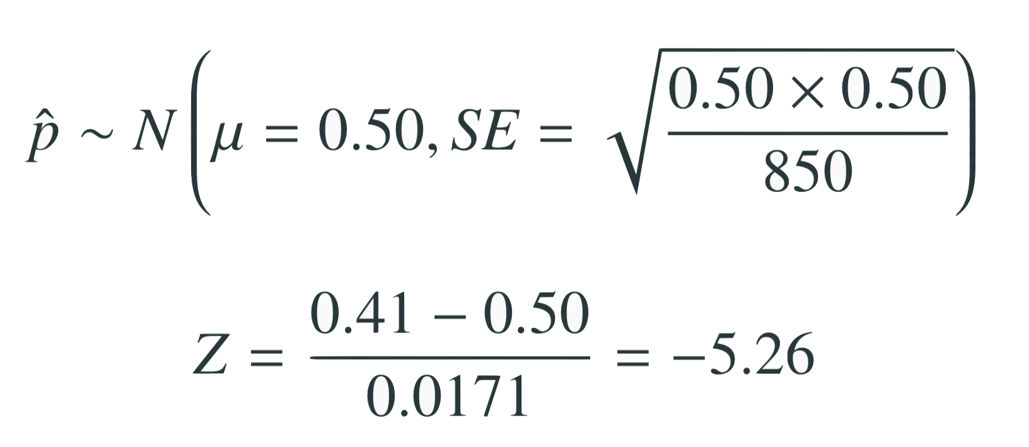
Test statistic
In order to evaluate if the observed sample mean is unusual for the hypothesized sampling distribution, we determine how many standard errors away from the null it is, which is also called the test statistic.
The sample proportion is 5.26 standard errors away from the hypothesized value. Is this considered unusually low? That is, is the result statistically significant?
Yes, and we can quantify how unusual it is using a p-value.

Slide 36
p-values
We then use this test statistic to calculate the p-value, the probability of observing data at least as favorable to the alternative hypothesis as our current data set, if the null hypothesis were true.
If the p-value is low (lower than the significance level, α, which is usually 5%) we say that it would be very unlikely to observe the data if the null hypothesis were true, and hence reject H₀.
If the p-value is high (higher than α) we say that it is likely to observe the data even if the null hypothesis were true, and hence do not reject H₀.

Slide 37
Facebook interest categories - p-value
p-value: probability of observing data at least as favorable to H_{A} as our current data set (a sample proportion lower than 0.41), if in fact H₀ were true (the true population proportion was 0.50).

Slide 38
Facebook interest categories
- Making a decision
p-value < 0.0001
If 50% of all American Facebook users are comfortable with Facebook creating these interest categories, there is less than a 0.01% chance of observing a random sample of 850 American Facebook users where 41% or fewer or 59% of higher feel comfortable with it.
This is a pretty low probability for us to think that the observed sample proportion, or something more extreme, is likely to happen simply by chance.
Since p-value is low (lower than 5%) we reject H₀.
The data provide convincing evidence that the proportion of American Facebook users who are comfortable with Facebook creating a list of interest categories for them is different than 50%.
The difference between the null value of 0.50 and observed sample proportion of 0.41 is not due to chance or sampling variability.

Slide 39
Choosing a significance level
Choosing a significance level for a test is important in many contexts, and the traditional level is 0.05. However, it is often helpful to adjust the significance level based on the application.
We may select a level that is smaller or larger than 0.05 depending on the consequences of any conclusions reached from the test.
If making a Type 1 Error is dangerous or especially costly, we should choose a small significance level (e.g. 0.01). Under this scenario we want to be very cautious about rejecting the null hypothesis, so we demand very strong evidence favoring H_{A} before we would reject H₀.
If a Type 2 Error is relatively more dangerous or much more costly than a Type 1 Error, then we should choose a higher significance level (e.g. 0.10). Here we want to be cautious about failing to reject H₀ when the null is actually false.

Slide 40
One vs. two sided hypothesis tests
In two sided hypothesis tests we are interested in whether p is either above or below some null value p₀: H_{A} : p ≠ p₀.
In one sided hypothesis tests we are interested in p differing from the null value p₀ in one direction (and not the other):
If there is only value in detecting if population parameter is less than p₀, then H_{A}: p < p₀.
If there is only value in detecting if population parameter is greater than p₀, then H_{A} : p > p₀.
Two-sided tests are often more appropriate as we often want to detect if the data goes clearly in the opposite direction of a hypothesis direction as well.

Slide 41
Find more resources at openintro.org/os, including
Slides
Videos
Statistical Software Labs
Discussion Forums (free support for students and teachers)
Learning Objectives
Teachers only content is also available for Verified Teachers, including
Exercise solutions
Sample exams
Ability to request a free desk copy for a course
Statistics Teachers email group
Questions? Contact us.

Slide 42
Extra Slides from the OS3 section on hypothesis testing

Slide 43
Testing hypotheses using confidence intervals
Earlier we calculated a 95% confidence interval for the average number of exclusive relationships college students have been in to be (2.7, 3.7). Based on this confidence interval, do these data support the hypothesis that college students on average have been in more than 3 exclusive relationships.

Slide 44
Testing hypotheses using confidence intervals
Earlier we calculated a 95% confidence interval for the average number of exclusive relationships college students have been in to be (2.7, 3.7). Based on this confidence interval, do these data support the hypothesis that college students on average have been in more than 3 exclusive relationships.
The associated hypotheses are:
H₀: µ = 3: College students have been in 3 exclusive relationships, on average
H_{A}: µ > 3: College students have been in more than 3 exclusive relationships, on average

Slide 45
Testing hypotheses using confidence intervals
Earlier we calculated a 95% confidence interval for the average number of exclusive relationships college students have been in to be (2.7, 3.7). Based on this confidence interval, do these data support the hypothesis that college students on average have been in more than 3 exclusive relationships.
The associated hypotheses are:
H₀: µ = 3: College students have been in 3 exclusive relationships, on average
H_{A}: µ > 3: College students have been in more than 3 exclusive relationships, on average
Since the null value is included in the interval, we do not reject the null hypothesis in favor of the alternative.

Slide 46
Testing hypotheses using confidence intervals
Earlier we calculated a 95% confidence interval for the average number of exclusive relationships college students have been in to be (2.7, 3.7). Based on this confidence interval, do these data support the hypothesis that college students on average have been in more than 3 exclusive relationships.
The associated hypotheses are:
H₀: µ = 3: College students have been in 3 exclusive relationships, on average
H_{A}: µ > 3: College students have been in more than 3 exclusive relationships, on average
Since the null value is included in the interval, we do not reject the null hypothesis in favor of the alternative.
This is a quick-and-dirty approach for hypothesis testing. However it doesn't tell us the likelihood of certain outcomes under the null hypothesis, i.e. the p-value, based on which we can make a decision on the hypotheses.

Slide 47
Number of college applications
A similar survey asked how many colleges students applied to, and 206 students responded to this question. This sample yielded an average of 9.7 college applications with a standard deviation of 7. College Board website states that counselors recommend students apply to roughly 8 colleges. Do these data provide convincing evidence that the average number of colleges all Duke students apply to is higher than recommended?
http://www.collegeboard.com/student/apply/the-application/151680.html

Slide 48
Setting the hypotheses
The parameter of interest is the average number of schools applied to by all Duke students.

Slide 49
Setting the hypotheses
The parameter of interest is the average number of schools applied to by all Duke students.
There may be two explanations why our sample mean is higher than the recommended 8 schools.
The true population mean is different.
The true population mean is 8, and the difference between the true population mean and the sample mean is simply due to natural sampling variability

Slide 50
Setting the hypotheses
The parameter of interest is the average number of schools applied to by all Duke students.
There may be two explanations why our sample mean is higher than the recommended 8 schools.
The true population mean is different.
The true population mean is 8, and the difference between the true population mean and the sample mean is simply due to natural sampling variability
We start with the assumption the average number of colleges Duke students apply to is 8 (as recommended)
H₀ : 𝝁 = 8

Slide 51
Setting the hypotheses
The parameter of interest is the average number of schools applied to by all Duke students.
There may be two explanations why our sample mean is higher than the recommended 8 schools.
The true population mean is different.
The true population mean is 8, and the difference between the true population mean and the sample mean is simply due to natural sampling variability
We start with the assumption the average number of colleges Duke students apply to is 8 (as recommended)
H₀ : 𝝁 = 8
We test the claim that the average number of colleges Duke students apply to is greater than 8
H_{A} : 𝝁 > 8

Slide 52
Number of college applications - conditions
Which of the following is not a condition that needs to be met to proceed with this hypothesis test?
Students in the sample should be independent of each other with respect to how many colleges they applied to.
Sampling should have been done randomly.
The sample size should be less than 10% of the population of all Duke students.
There should be at least 10 successes and 10 failures in the sample.
The distribution of the number of colleges students apply to should not be extremely skewed.

Slide 53
Number of college applications - conditions
Which of the following is not a condition that needs to be met to proceed with this hypothesis test?
Students in the sample should be independent of each other with respect to how many colleges they applied to.
Sampling should have been done randomly.
The sample size should be less than 10% of the population of all Duke students.
There should be at least 10 successes and 10 failures in the sample.
The distribution of the number of colleges students apply to should not be extremely skewed.

Slide 54
Test Statistic
In order to evaluate if the observed sample mean is unusual for the hypothesized sampling distribution, we determine how many standard errors away from the null it is, which is also called the test statistic.

Slide 55
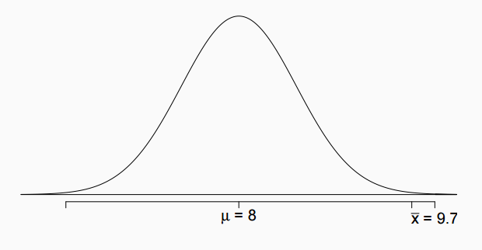
Test Statistic
In order to evaluate if the observed sample mean is unusual for the hypothesized sampling distribution, we determine how many standard errors away from the null it is, which is also called the test statistic.

Slide 56
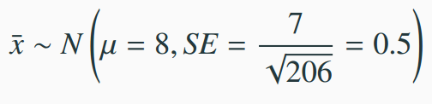
Test Statistic
In order to evaluate if the observed sample mean is unusual for the hypothesized sampling distribution, we determine how many standard errors away from the null it is, which is also called the test statistic.

Slide 57
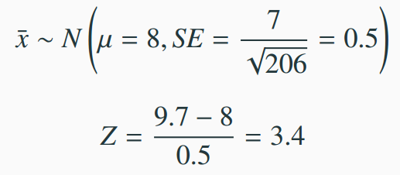
Test Statistic
In order to evaluate if the observed sample mean is unusual for the hypothesized sampling distribution, we determine how many standard errors away from the null it is, which is also called the test statistic.

Slide 58
Test Statistic
In order to evaluate if the observed sample mean is unusual for the hypothesized sampling distribution, we determine how many standard errors away from the null it is, which is also called the test statistic.
The sample mean is 3.4 standard errors away from the hypothesized value. Is this considered unusually high? That is, is the result statistically significant?

Slide 59
Test Statistic
In order to evaluate if the observed sample mean is unusual for the hypothesized sampling distribution, we determine how many standard errors away from the null it is, which is also called the test statistic.
The sample mean is 3.4 standard errors away from the hypothesized value. Is this considered unusually high? That is, is the result statistically significant?
Yes, and we can quantify how unusual it is using a p-value.

Slide 60
p-values
We then use this test statistic to calculate the p-value, the probability of observing data at least as favorable to the alternative hypothesis as our current data set, if the null hypothesis were true.

Slide 61
p-values
We then use this test statistic to calculate the p-value, the probability of observing data at least as favorable to the alternative hypothesis as our current data set, if the null hypothesis were true.
If the p-value is low (lower than the significance level, α, which is usually 5%) we say that it would be very unlikely to observe the data if the null hypothesis were true, and hence reject H₀.

Slide 62
p-values
We then use this test statistic to calculate the p-value, the probability of observing data at least as favorable to the alternative hypothesis as our current data set, if the null hypothesis were true.
If the p-value is low (lower than the significance level, α, which is usually 5%) we say that it would be very unlikely to observe the data if the null hypothesis were true, and hence reject H₀.
If the p-value is high (higher than α) we say that it is likely to observe the data even if the null hypothesis were true, and hence do not reject H₀.

Slide 63
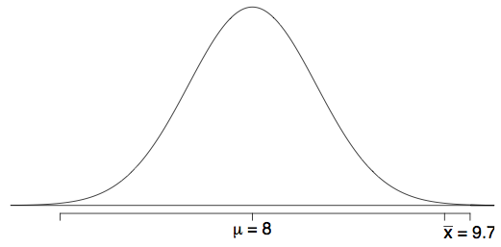
Number of college applications - p-value
p-value: probability of observing data at least as favorable to H_{A} as our current data set (a sample mean greater than 9.7), if in fact H₀ were true (the true population mean was 8).

Slide 64
Number of college applications - p-value
p-value: probability of observing data at least as favorable to H_{A} as our current data set (a sample mean greater than 9.7), if in fact H₀ were true (the true population mean was 8).
P(x̄ > 9.7 | µ = 8) = P(Z > 3.4) = 0.0003

Slide 65
Number of college applications - Making a decision
p-value = 0.0003

Slide 66
Number of college applications - Making a decision
p-value = 0.0003
If the true average of the number of colleges Duke students applied to is 8, there is only 0.03% chance of observing a random sample of 206 Duke students who on average apply to 9.7 or more schools.

Slide 67
Number of college applications - Making a decision
p-value = 0.0003
If the true average of the number of colleges Duke students applied to is 8, there is only 0.03% chance of observing a random sample of 206 Duke students who on average apply to 9.7 or more schools.
This is a pretty low probability for us to think that a sample mean of 9.7 or more schools is likely to happen simply by chance.

Slide 68
Number of college applications - Making a decision
p-value = 0.0003
If the true average of the number of colleges Duke students applied to is 8, there is only 0.03% chance of observing a random sample of 206 Duke students who on average apply to 9.7 or more schools.
This is a pretty low probability for us to think that a sample mean of 9.7 or more schools is likely to happen simply by chance.
Since p-value is low (lower than 5%) we reject H₀.

Slide 69
Number of college applications - Making a decision
p-value = 0.0003
If the true average of the number of colleges Duke students applied to is 8, there is only 0.03% chance of observing a random sample of 206 Duke students who on average apply to 9.7 or more schools.
This is a pretty low probability for us to think that a sample mean of 9.7 or more schools is likely to happen simply by chance.
Since p-value is low (lower than 5%) we reject H₀.
The data provide convincing evidence that Duke students apply to more than 8 schools on average.

Slide 70
Number of college applications - Making a decision
p-value = 0.0003
If the true average of the number of colleges Duke students applied to is 8, there is only 0.03% chance of observing a random sample of 206 Duke students who on average apply to 9.7 or more schools.
This is a pretty low probability for us to think that a sample mean of 9.7 or more schools is likely to happen simply by chance.
Since p-value is low (lower than 5%) we reject H₀.
The data provide convincing evidence that Duke students apply to more than 8 schools on average.
The difference between the null value of 8 schools and observed sample mean of 9.7 schools is not due to chance or sampling variability.

Slide 71
Practice
A poll by the National Sleep Foundation found that college students average about 7 hours of sleep per night. A sample of 169 college students taking an introductory statistics class yielded an average of 6.88 hours, with a standard deviation of 0.94 hours. Assuming that this is a random sample representative of all college students (bit of a leap of faith?), a hypothesis test was conducted to evaluate if college students on average sleep less than 7 hours per night. The p-value for this hypothesis test is 0.0485. Which of the following is correct?
Fail to reject H₀, the data provide convincing evidence that college students sleep less than 7 hours on average.
Reject H₀, the data provide convincing evidence that college students sleep less than 7 hours on average.
Reject H₀, the data prove that college students sleep more than 7 hours on average.
Fail to reject H₀, the data do not provide convincing evidence that college students sleep less than 7 hours on average.
Reject H₀, the data provide convincing evidence that college students in this sample sleep less than 7 hours on average.

Slide 72
Practice
A poll by the National Sleep Foundation found that college students average about 7 hours of sleep per night. A sample of 169 college students taking an introductory statistics class yielded an average of 6.88 hours, with a standard deviation of 0.94 hours. Assuming that this is a random sample representative of all college students (bit of a leap of faith?), a hypothesis test was conducted to evaluate if college students on average sleep less than 7 hours per night. The p-value for this hypothesis test is 0.0485. Which of the following is correct?
Fail to reject H₀, the data provide convincing evidence that college students sleep less than 7 hours on average.
Reject H₀, the data provide convincing evidence that college students sleep less than 7 hours on average.
Reject H₀, the data prove that college students sleep more than 7 hours on average.
Fail to reject H₀, the data do not provide convincing evidence that college students sleep less than 7 hours on average.
Reject H₀, the data provide convincing evidence that college students in this sample sleep less than 7 hours on average.

Slide 73
Two-sided hypothesis testing with p-values
If the research question was “Do the data provide convincing evidence that the average amount of sleep college students get per night is different than the national average?”, the alternative hypothesis would be different
H₀: µ = 7
H_{A}: µ ≠ 7

Slide 74
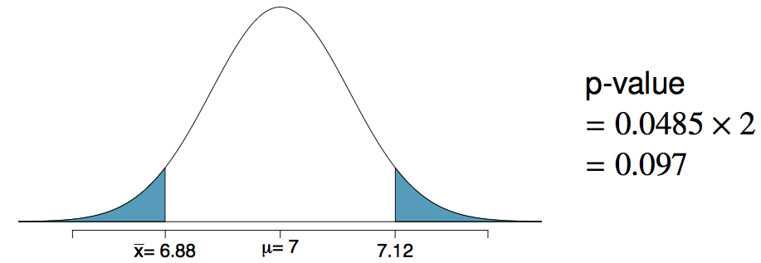
Two-sided hypothesis testing with p-values
If the research question was “Do the data provide convincing evidence that the average amount of sleep college students get per night is different than the national average?”, the alternative hypothesis would be different
H₀: µ = 7
H_{A}: µ ≠ 7
Hence the p-value would change as well:

Slide 75
Choosing a significance level
Choosing a significance level for a test is important in many contexts, and the traditional level is 0.05. However, it is often helpful to adjust the significance level based on the application.
We may select a level that is smaller or larger than 0.05 depending on the consequences of any conclusions reached from the test.
If making a Type 1 Error is dangerous or especially costly, we should choose a small significance level (e.g. 0.01). Under this scenario we want to be very cautious about rejecting the null hypothesis, so we demand very strong evidence favoring H_{A} before we would reject H₀.
If a Type 2 Error is relatively more dangerous or much more costly than a Type 1 Error, then we should choose a higher significance level (e.g. 0.10). Here we want to be cautious about failing to reject H₀ when the null is actually false.

Slide 76
the next two slides provide a brief summary of hypothesis testing...

Slide 77
Recap: Hypothesis testing framework
Set the hypotheses.
Check assumptions and conditions.
Calculate a test statistic and a p-value.
Make a decision, and interpret it in context of the research question.

Slide 78

Recap: Hypothesis testing for a population mean
1. Set the hypotheses
H₀: µ = null value
H_{A}: µ < or > or ≠ null value
2. Calculate the point estimate
3. Check assumptions and conditions
Independence: random sample/assignment, 10% condition when sampling without replacement
Normality: nearly normal population or n ≥ 30, no extreme skew -- or use the t distribution (Ch 5)
4. Calculate a test statistic and a p-value (draw a picture!)
5. Make a decision, and interpret it in context
If p-value < α, reject H₀, data provide evidence for H_{A}
If p-value > α, do not reject H₀, data do not provide evidence for H_{A}

